Slide 1
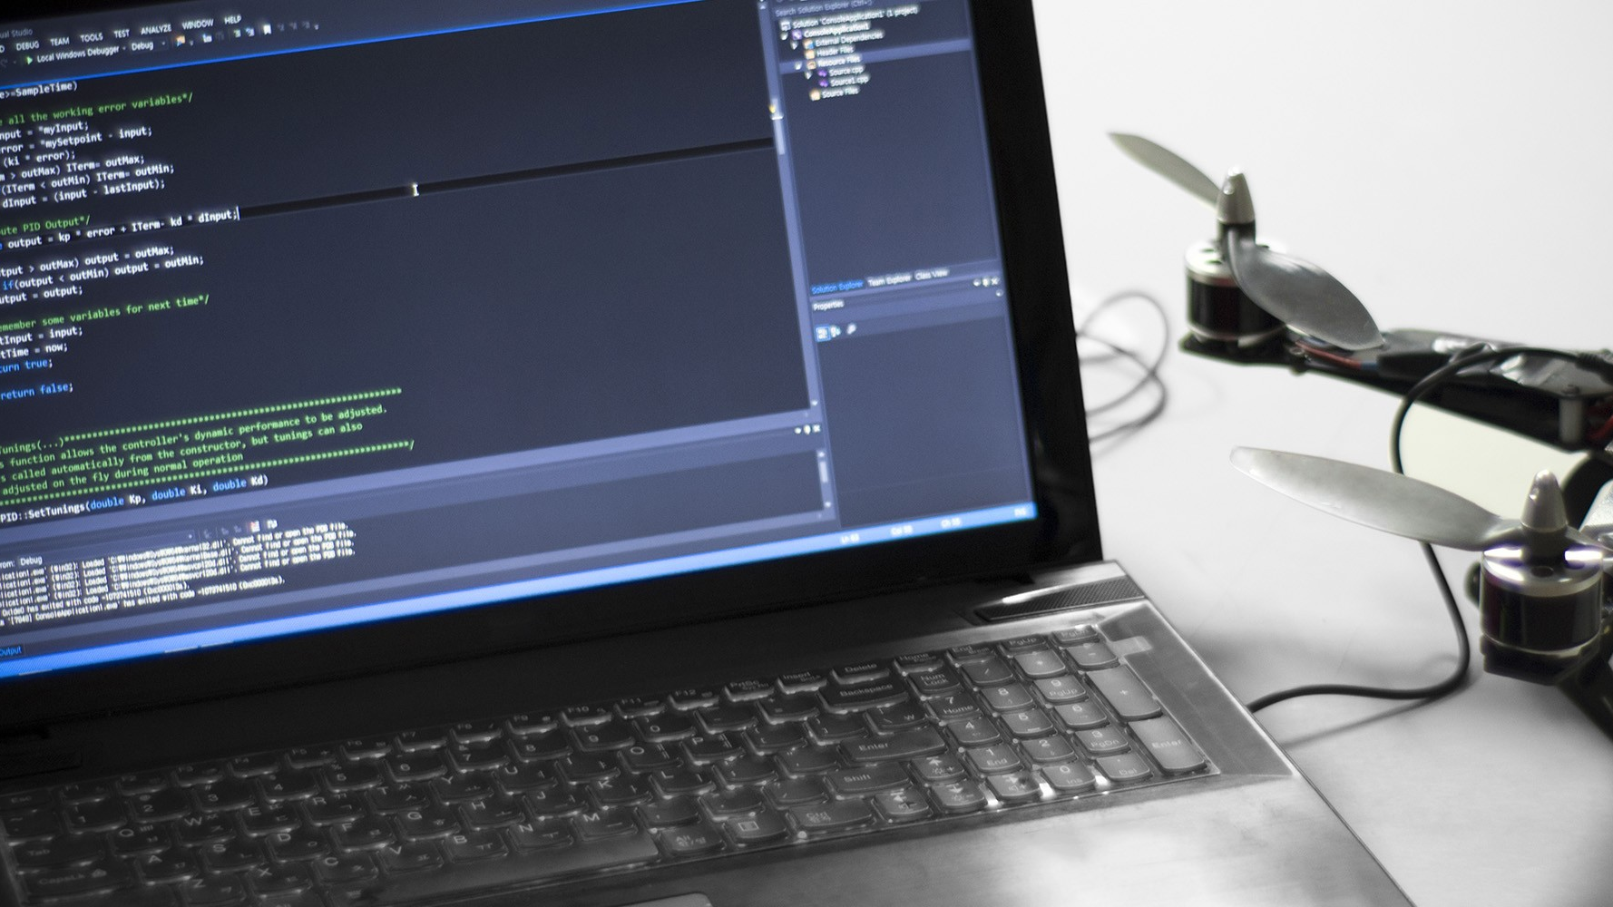
성 균 관 대 학 교
S I O R
로 봇 학 회

Slide 2
2022년 06월 24일
AI
6 주 차

Slide 3
목차
Review
Conv Net
Conv Net - Skills
Code example (w/ MNIST)

Slide 4
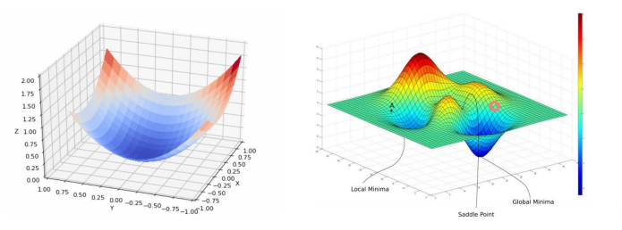
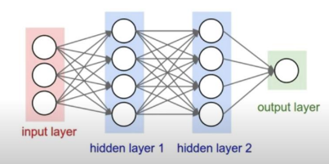
AI
Review
Linear Regression
Cost minimization
Logistic Regression
Softmax, Entropy
Overfitting
Deep Learning
Neural Net
BackProPagation
Skills
Activation func
Weight initialization
Dropout
Batch Normalization

Slide 5
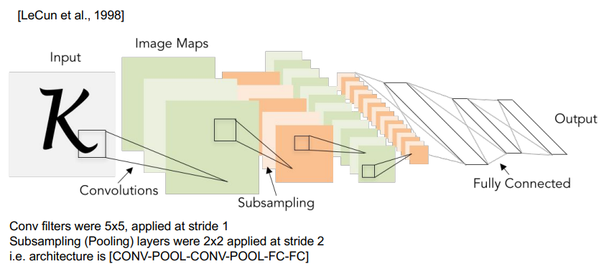
AI
Conv Net - Background
...

Slide 6
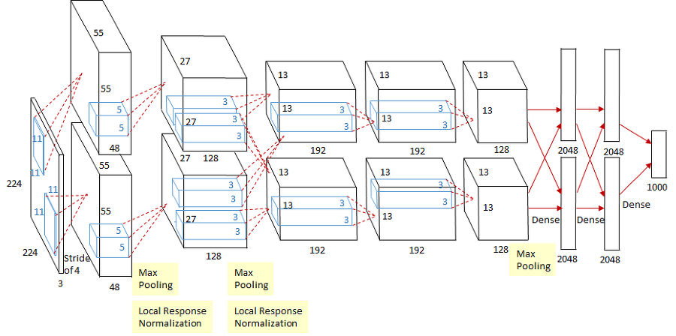
AI
Conv Net – AlexNet
...

Slide 7
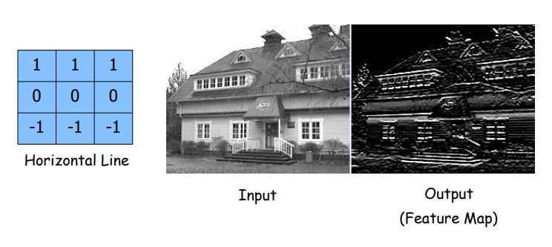
AI
Conv Net - Skills
...

Slide 8
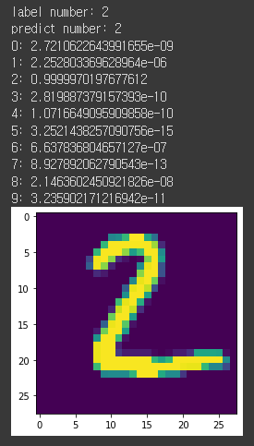
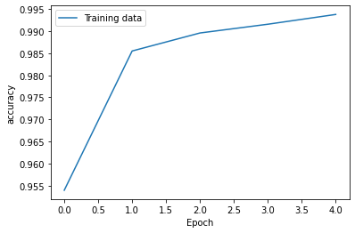
AI
Code example (w/MNIST)
...

Slide 9
AI
Reference
Convolutional Neural Networks (Course 4 of the Deep Learning Specialization), DeepLearningAI, Youtube, 2017.11.08. Accessed: 22.06.24, https://www.youtube.com/watch?v=ArPaAX_PhIs&list=PLkDaE6sCZn6Gl29AoE31iwdVwSG-KnDzF
Lecture Collection | Convolutional Neural Networks for Visual Recognition (Spring 2017), Stanford University School of Engineering, Youtube, 2017.08.12., Accessed: 22.06.24, https://www.youtube.com/watch?v=vT1JzLTH4G4

Slide 10
성 균 관 대 학 교
Thank You
로 봇 학 회

